Slide 1
Lab 3: Digital Signal Processing
Sean Prokop
Winter 2019

Slide 2
Objective
What is the objective of this lab (in your own words)?

Slide 3
Part 1: Signal Processing with MATLAB and Arduino

Slide 4
Challenge #1 - Onramp Tutorial
Part 1
Add a screen shot of your certificate for completing the MATLAB Onramp Tutorial
(This can be the same screen shot you submitted earlier to GradeScope)
What were some of the main highlights of what you learned in this Tutorial?

Slide 5
Challenge #2A - Creating a signal in MATLAB
Part 1
(2A.1a) Copy your sine wave plot at Frequency 500 Hz Amplitude 1
(2A.1b) Copy your sine wave plot at Frequency 1000 Hz Amplitude 0.5
(2A.1c) Copy your sine wave plot at Frequency 3000 Hz Amplitude 3

Slide 6
Challenge #2A - Creating a signal in MATLAB
Part 1
(2A.2) Copy your 3 plots with different sampling frequencies here. Use subplot to so that there are 3 plots in one figure window. Remember to title your plots and label axes.
(2A.3) Comment on how the shape of the sine wave changes as you change the sampling frequency. Do certain plots look better than others?

Slide 7
Challenge #2B - Creating a signal in MATLAB + Arduino
Part 1
(2B.1a) Copy your 0.5 Hz “sine wave” plot here.
(2B.2) Copy your 0.5 Hz “square wave” plot here.
(2B.1b) Copy your 2 Hz “sine wave” plot here.
(2B.3) What was your amplitude for each wave?

Slide 8
Challenge #3A – Generating Signals via Functions
Part 1
Copy your three plots in the same figure window with different sine wave frequencies / sample rates here. Use subplot. Remember to title your plots and label axes.

Slide 9
Challenge #3B – Sampling with MATLAB & Arduino
Part 1
(3B.3a) Copy the full figure window for 1Hz including the resampled figures.
(3B.3b) Copy the full figure window for 2Hz including the resampled figures.
(3B.4) Compare the subplots sampling at different frequencies. What’s the effect on having a lower sampling frequency? Why?

Slide 10
Challenge #4A – Time vs. Frequency Representations
Part 1
Copy a picture of your generated signals.
(4A.1) What can you read from the power spectrum plots? What does the spike mean?
(4A.2) What’s the benefit on analyzing signals using power spectrum plot (frequency domain)? Especially on the combined signal?

Slide 11
Challenge #4B – Time vs. Frequency Representations
Part 1
Screenshot of ~20 seconds 1 Hz “sine wave” with time-domain plot, power spectrum (PS) plot and spectrogram.
Screenshot of ~20 seconds 2 Hz “sine wave” with time-domain plot, power spectrum plot and spectrogram.

Slide 12
Challenge #4B – Time vs. Frequency Representations
Part 1
(4B.1) What did you observe on the power spectrum plot (second subplot) on your two screenshots? What does it mean?
(4B.2) What did you notice on the spectrogram? How is that related to your hand moving frequencies?
(4B.3) On top of the MATLAB script, change the FFT_PLOT_DURATION from 20 seconds to 5 seconds. What’s the effect? Why?

Slide 13
Part 2: Image Processing with MATLAB

Slide 14


Challenge #1 - Pixels and Matrices
Part 2
clear; close all; clc;
figure(1)
A=[255 0 255 0 255 0; 0 255 0 255 0 255];
A(3,:)=A(1,:);
A(4,:)=A(2,:);
A(5,:)=A(1,:);
A(6,:)=A(2,:);
imshow(uint8(A));
truesize(gcf, [100 100]);
set(gcf, 'Units', 'normalized', 'Position', [0.1,0.1,0.7,0.7]);
figure(2)
B1=[255*ones(6,3) zeros(6,2) 75*ones(6,1) 238*ones(6,1)];
B2=[zeros(6,1) 165*ones(6,1) 255*ones(6,2) zeros(6,2) 130*ones(6,1)];
B3=[zeros(6,4) 255*ones(6,1) 130*ones(6,1) 238*ones(6,1)];
B(:,:,1)=B1;
B(:,:,2)=B2;
B(:,:,3)=B3;
imshow(uint8(B))
truesize(gcf,[100 100])
set (gcf, 'Units', 'normalized', 'Position', [0.1,0.1,0.7,0.7]);
A grayscale image is a 2 dimensional matrix while a color image is a 3 dimensional matrix, with the third dimension being for RGB.
The values represent the intensity of each pixel. For grayscale, 0 is black and 255 is white, between that is gray. For color, the intensity is defined by an R, G, and B value.

Slide 15
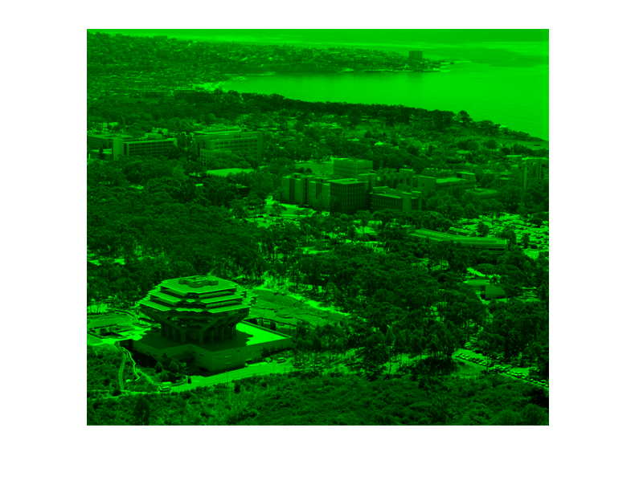
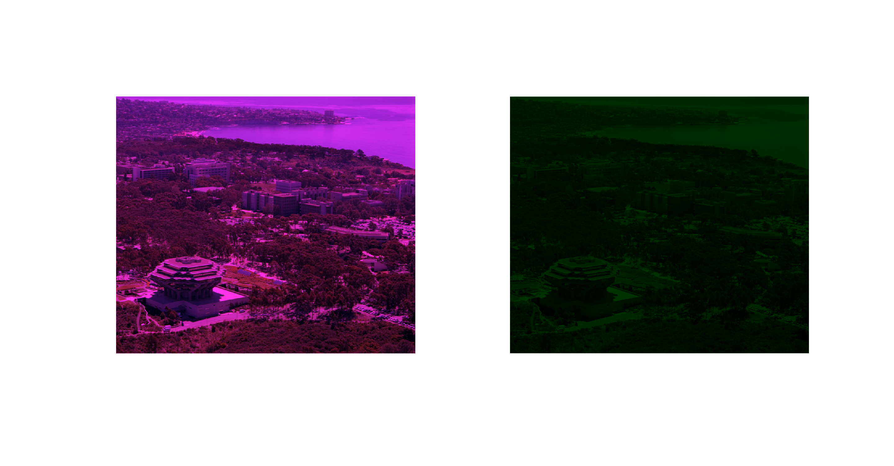
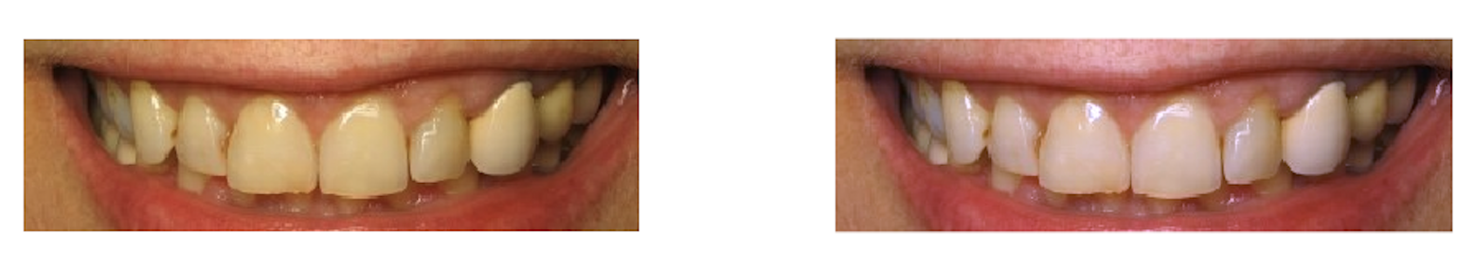
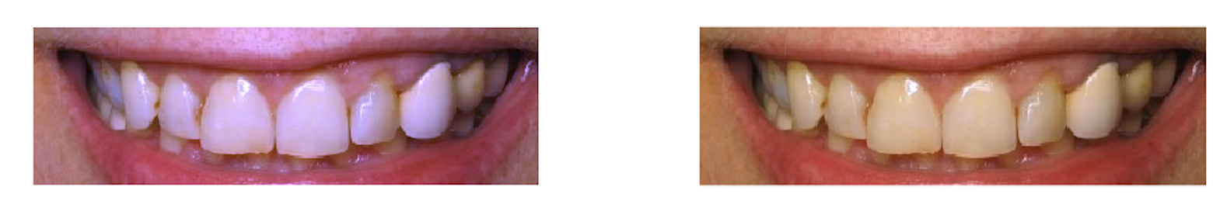
Challenge #2 - Exploring the Image Structure
Part 2
The original image looks better because the new image has the green value scaled down by 0.2.
Different blue scale images
Original vs New image

Slide 16
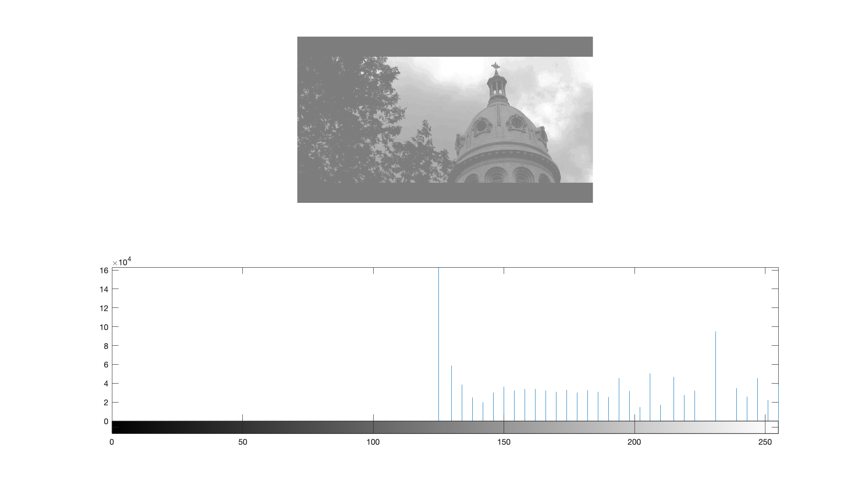
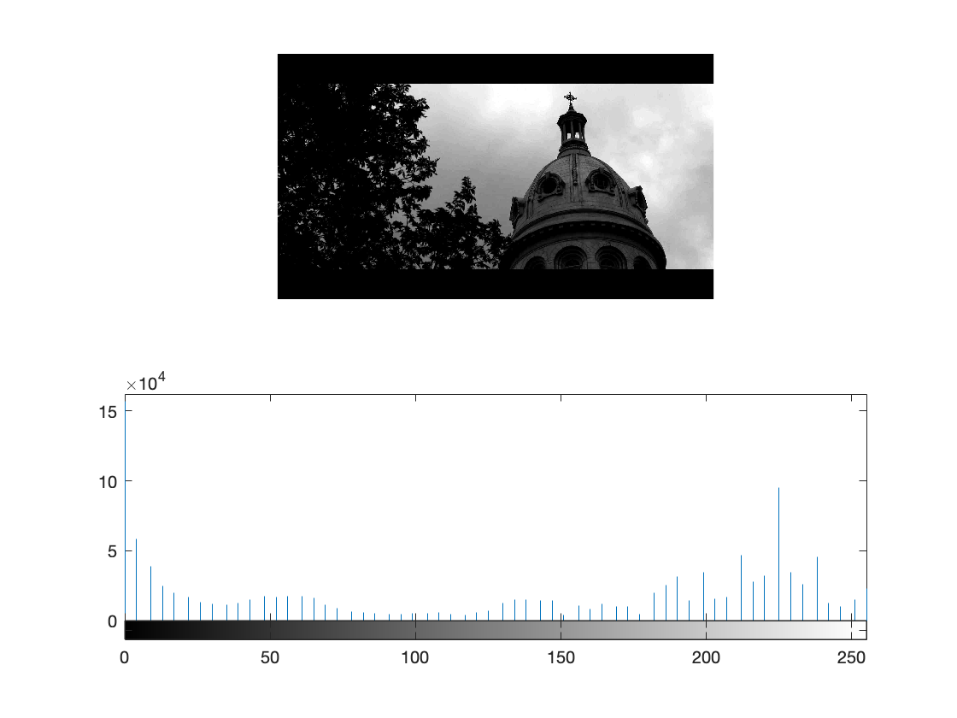
Challenge #3 - Image Histograms
Part 2
The contrast stretched image looks better. Contrast stretching added empty values between bins such that the histogram is evenly spread over the whole range. Histogram equalization tries to even out the distribution of intensities across all bins.

Slide 17
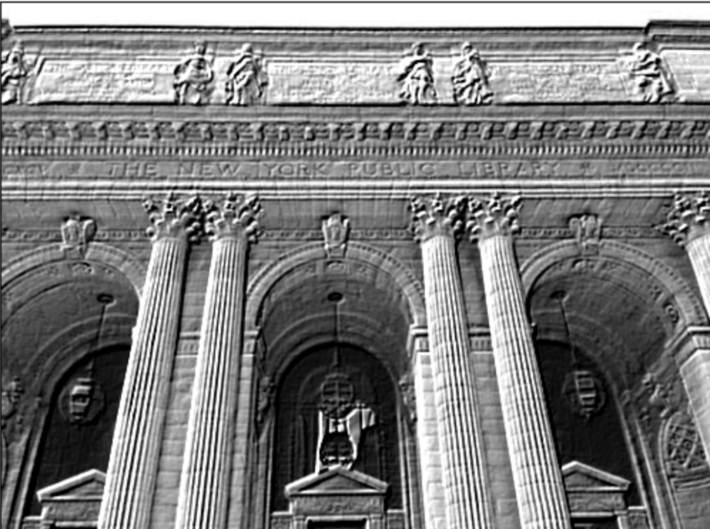
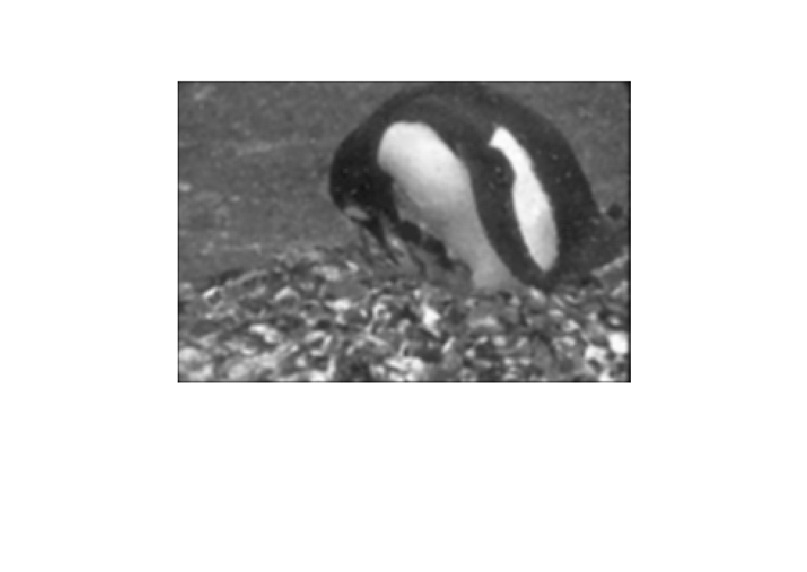
Challenge #4 - Image Filtering
Part 2
Emboss
Noise is a random variation of the intensity of pixels, and also the color of the pixels. A mean filter can be used to replace the value of each pixel with the mean average of all the pixels surrounding it. A median filter does the same but with median instead of average.
Using these can help to get rid of different types of noise.

Slide 18
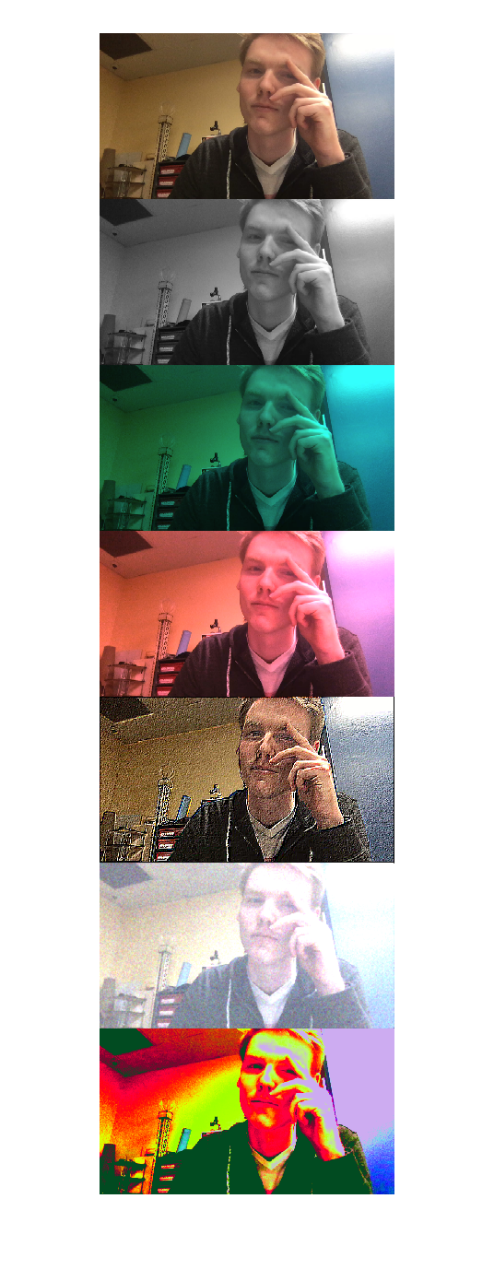
Challenge #5 – Photobooth Challenge
Part 2
%% noise and filter with color enhancement
noisy=imnoise(img,'gaussian',0.4);
med1=medfilt2(noisy(:,:,1));
med2=medfilt2(noisy(:,:,2));
med3=medfilt2(noisy(:,:,3));
med=cat(3,med1,med2.*1.1,med3.*1.3);

Slide 19
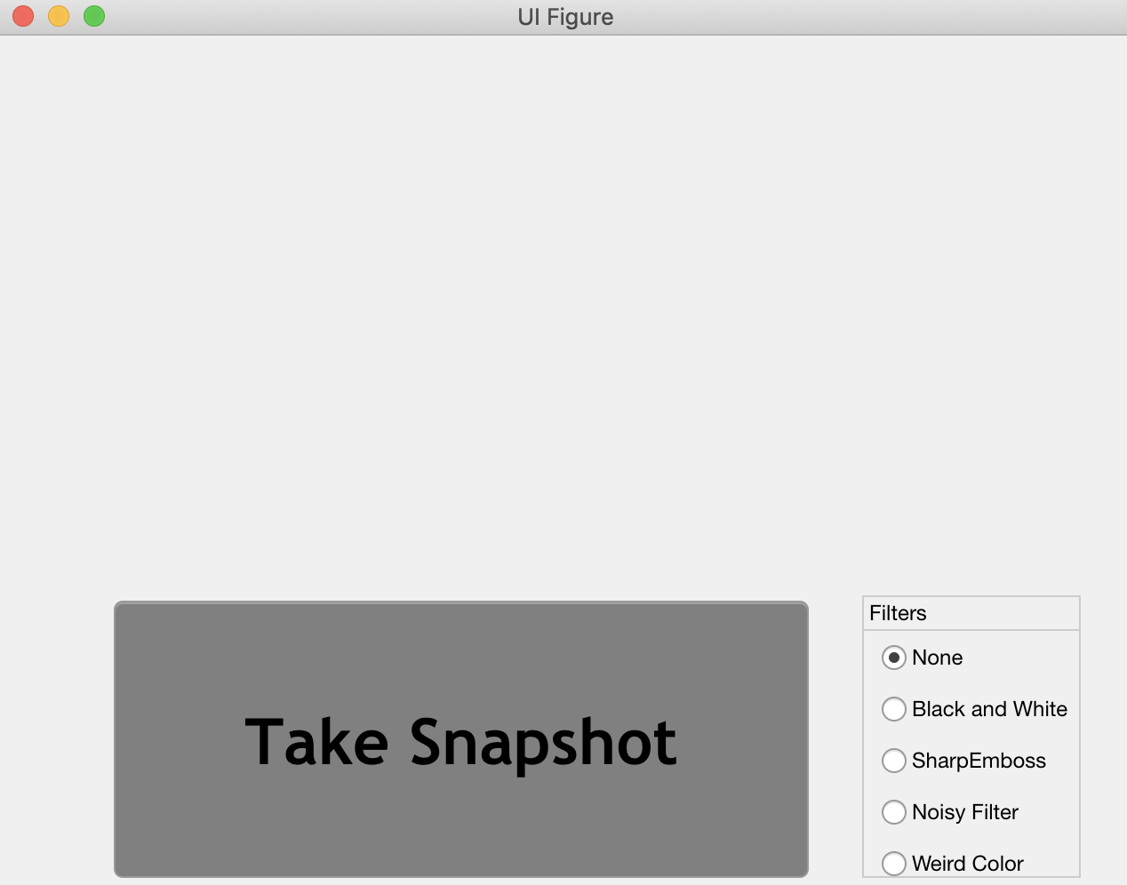
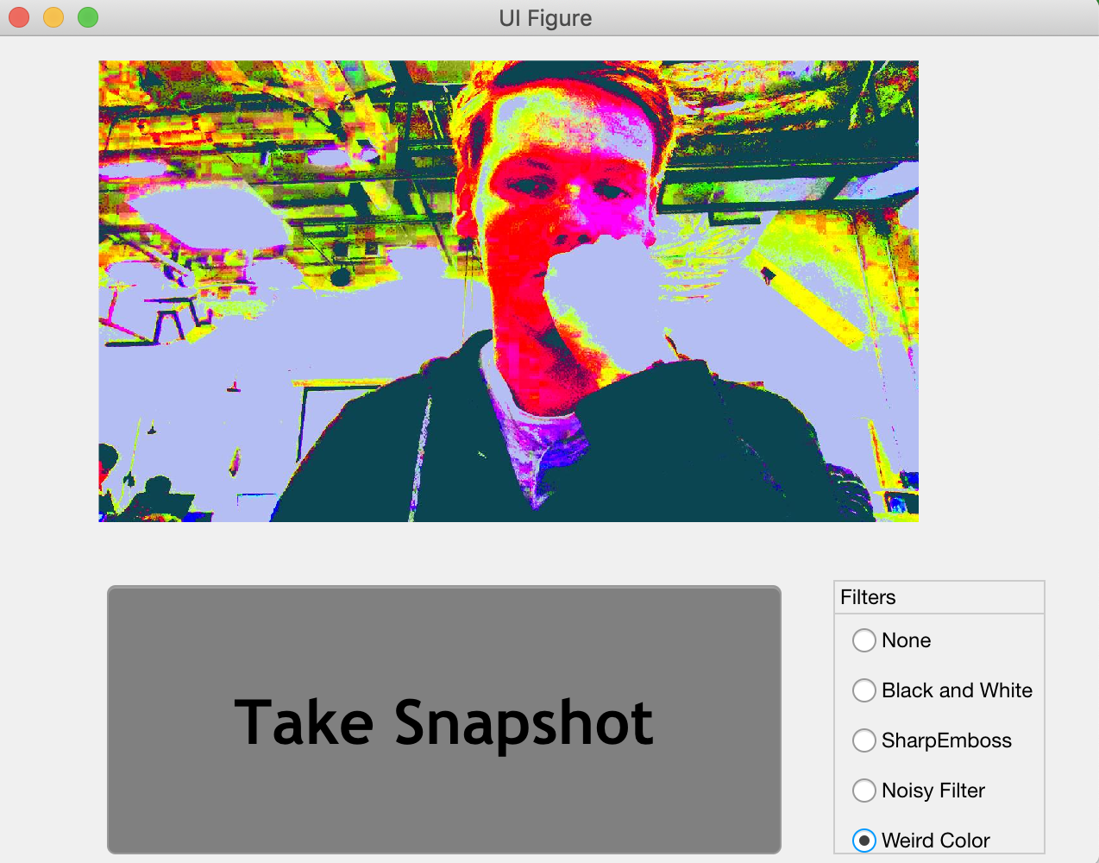
Final Challenge – Photobooth Ch. with App Designer
Part 2
Place a picture of your GUI made with App Designer here (This will be explained in class on Wednesday February 20th)
Place a picture of an example of your output here. Remember to submit your code to gradescope.

Slide 20
Extra Credit – Advanced Photobooth with App Designer
Part 2
Place a picture of your Extra Credit GUI made with App Designer here (This will be explained in class on Wednesday February 20th)
Place a picture of an example of your output here. Remember to submit your code and video to grade scope.

Slide 21
Part 1 & 2
Lab Experience
Advantages of digital signal processing include changeability – you can easily change the parameters of the filter without needing to replace components and precision – you can get more accurate filtering digitally.
A disadvantage is also precision, as the analog signal needs to be quantized so it can be processed digitally, which is inherently lossy.
The most valuable part of this lab for me was getting to implement image filters. I love DSP and image processing is very fun so I had a good time with it. I have no further questions and did not do anything outside of this lab.

